Slide 1



Automatic gate discovery plus cross-sample applying/aligning using AutoGate
Wayne Moore¹ (1979-2020)¹, Connor Meehan² (2012-2020) & Stephen Meehan¹ (2000-2020)
Department of Genetics, Stanford University
Department of Mathematics, California Institute of Technology
Herzenberg 60th anniversary meeting
Friday, February 14, 2020

Slide 2
What is AutoGate?
Software application for flow cytometry analysis
First released in March 2014
Provides full automation of compensation and biexponential
Until 2017 provided only partial automation of gating… doing only one of the three principal tasks of conventional gating
  Choosing parameters for a 2D projection
  Drawing boundaries around subsets
  Choosing a subset on which to gate further
Notes:
AutoGate was released around 4 years ago.
It’s major value proposition is that it provides novel automation for the main tasks of flow analysis.
It’s major limitation is that being semi-supervised, full automation only occurs after some guidance.
While this is less guidance than conventional manual gating, it must be refreshed when you expect non neglible variance in samples or gating.
User must
Specific sample types and labels for compensation and biexponential
Guide the construction of a 2D gating hierarchy
What 2 parameters to use for each level of the hierarchy?
Which one or more clusters to use for the next level?

Slide 3
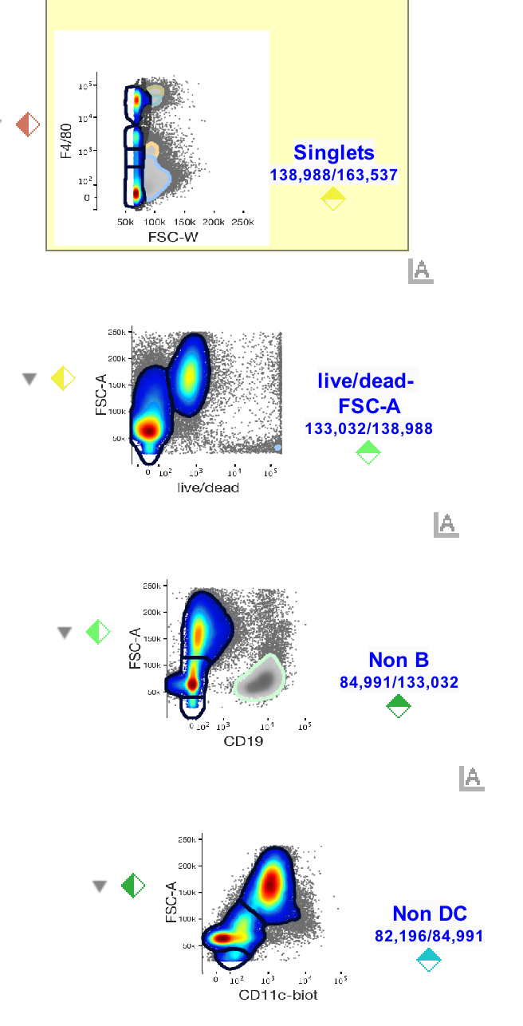
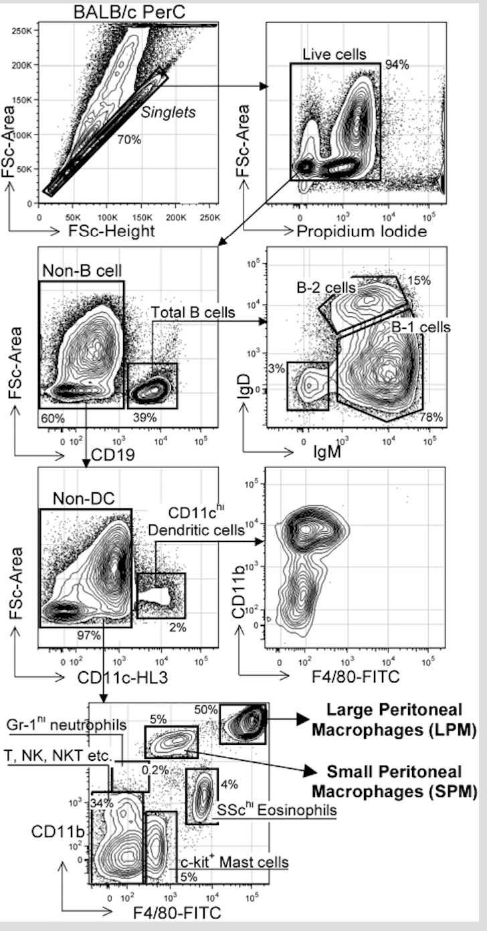
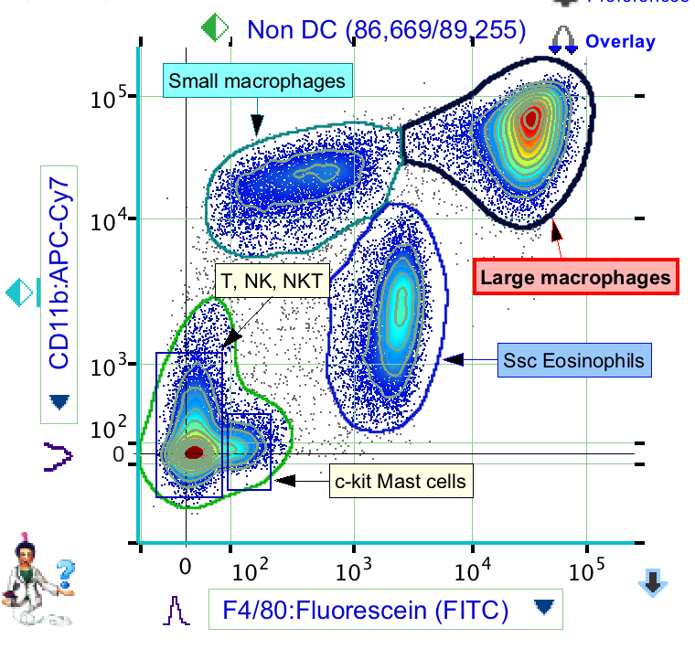
AutoGate’s 2014-2017 workflow illustrated
Conventional gating
AutoGate’s partially automated gating
HOWEVER…
In 2017 unsupervised HiD methods like tSNE gained so much adoption that it became clear AutoGate MUST evolve …
But evolve without the “curse-of-dimensionality”
challenges of tSNE & other all-at-once
clustering methods….
AutoGate allows manual gates along side of cluster-picked gates

Slide 4
Since 2018 AutoGate has been acquiring
fully automatic HiD analysis capabilities
The 2 most important capabilities have been
Exhaustive Projection Pursuit (Epp)
  Discovers subsets with no training/guidance … Epp assumes you know very little!
  Introduced in January 2018
UMAP Supervised templates (UST)
  Applies/aligns subsets discovered in one sample to other samples… UST assumes you know alot!
  Introduced in September 2019

Slide 5
Epp
Wayne Moore

Slide 6
Exhaustive Projection Pursuit (EPP)
If there exists a projection on any pair of dimensions, in which the data can be cleanly split, that cannot be wrong and it divides the problem into two simpler parts.
Applied recursively, a divide and conquer strategy can be carried out to identify subpopulations until no further splits are available.
What would it take to perform this automatically?
  Examine all two dimensional projections
  Find all suitable candidate separatricies.
  Compare them and choose the best one
  Use it to divide the problem into two parts
  Evaluate the significance of the terminal splits, i.e., one blob or two?
  Present the results to the user in a comprehensible form.

Slide 7
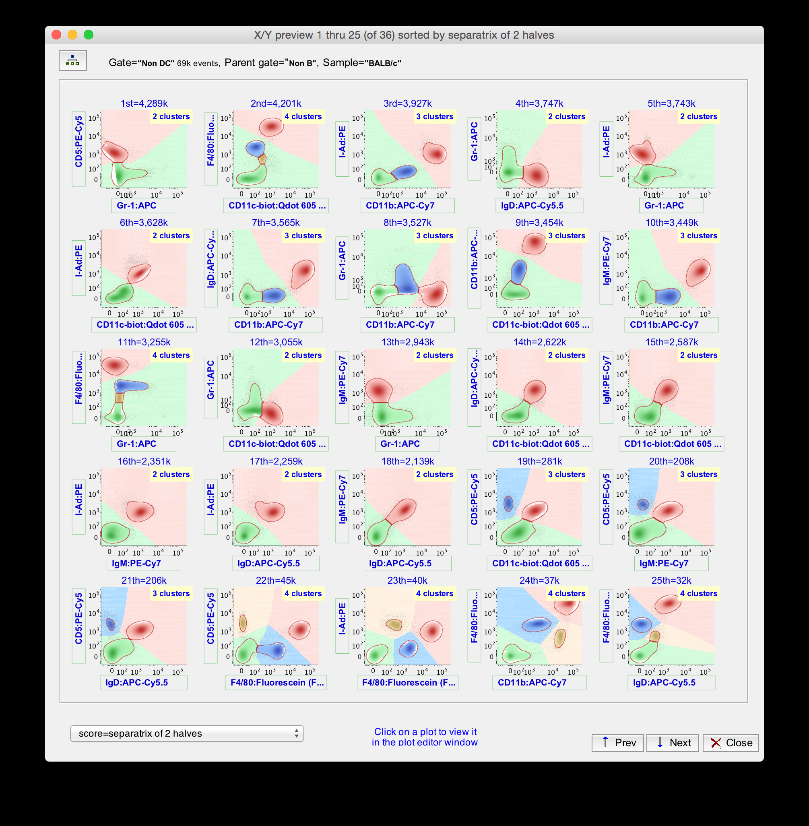
Modal Clustering and
Assignment Of Background

Slide 8
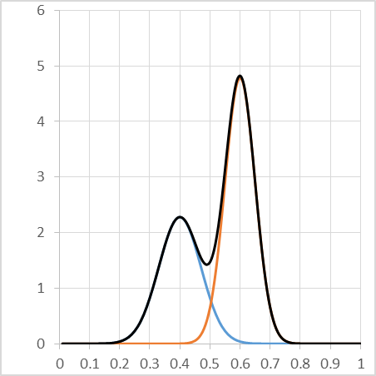
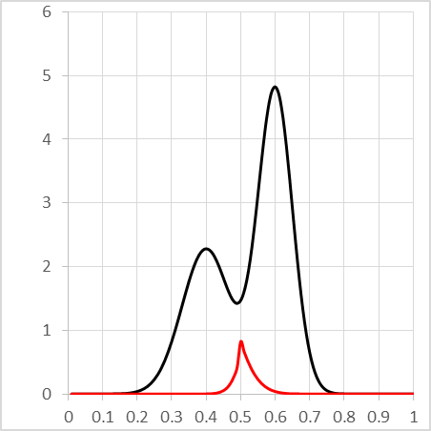
Exhaustive Projection Pursuit
Rank By Classifier Error
Population Mixture
Error Of Classifier

Slide 9
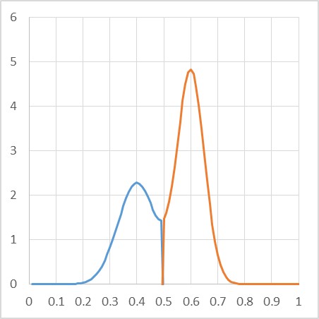
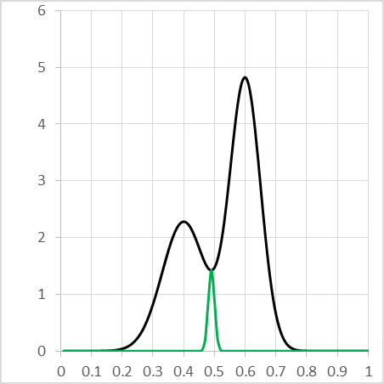
Exhaustive Projection Pursuit
Rank By Sort Reproducibility
Population Mixture
Error Of Sorter

Slide 10
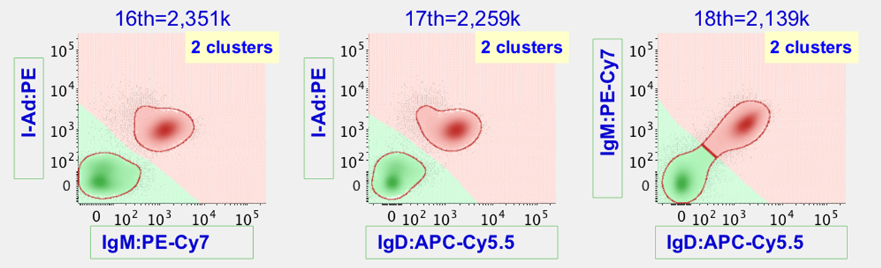
Exhaustive Projection Pursuit
Minimize Weight Along Separatrix
When there are only two subsets, add up the weights of all the border points as an approximation of the line integral of the density over the separatrix. Multiplied by the standard error of the sorter this is the probability of a wrong sort.

Slide 11
Exhaustive Projection Pursuit
Three Or More Subpopulations
When there are more subpopulations, the conservative choice is to take the best division into only two parts
Simplifying the problem may expose a better separation of the other populations in a later step
If the other divisions are in fact optimal, they will be taken in the next step and we’ve only wasted time

Slide 12
Exhaustive Projection Pursuit
Sepratrix Ranking for Balance
>

Slide 13
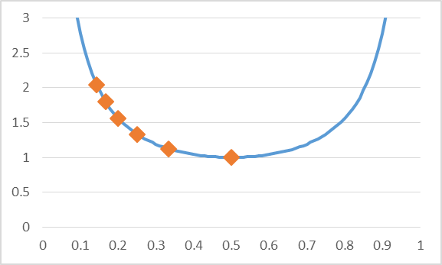
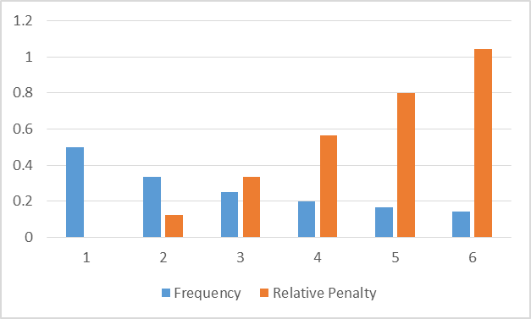
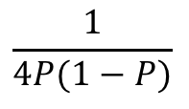
Exhaustive Projection Pursuit
Penalty for Imbalance
$$\frac{1}{4P(1−P)}$$

Slide 14
Exhaustive Projection Pursuit
Best Balance vs Best Separated
Best Balanced most similar to conventional analysis
Best Separated better for rare populations and gives cleaner sorting gates

Slide 15
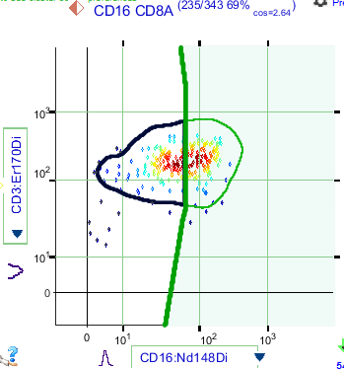
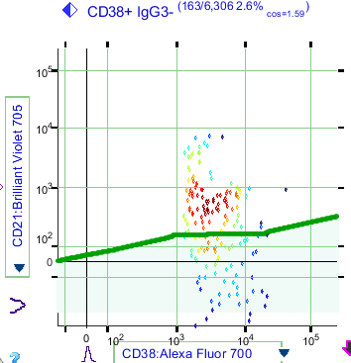
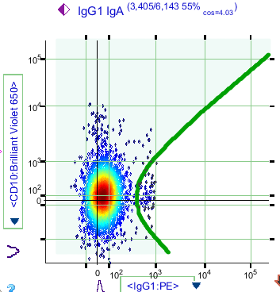
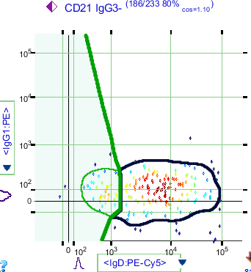
Exhaustive Projection Pursuit
End Stage Decisions

Slide 16
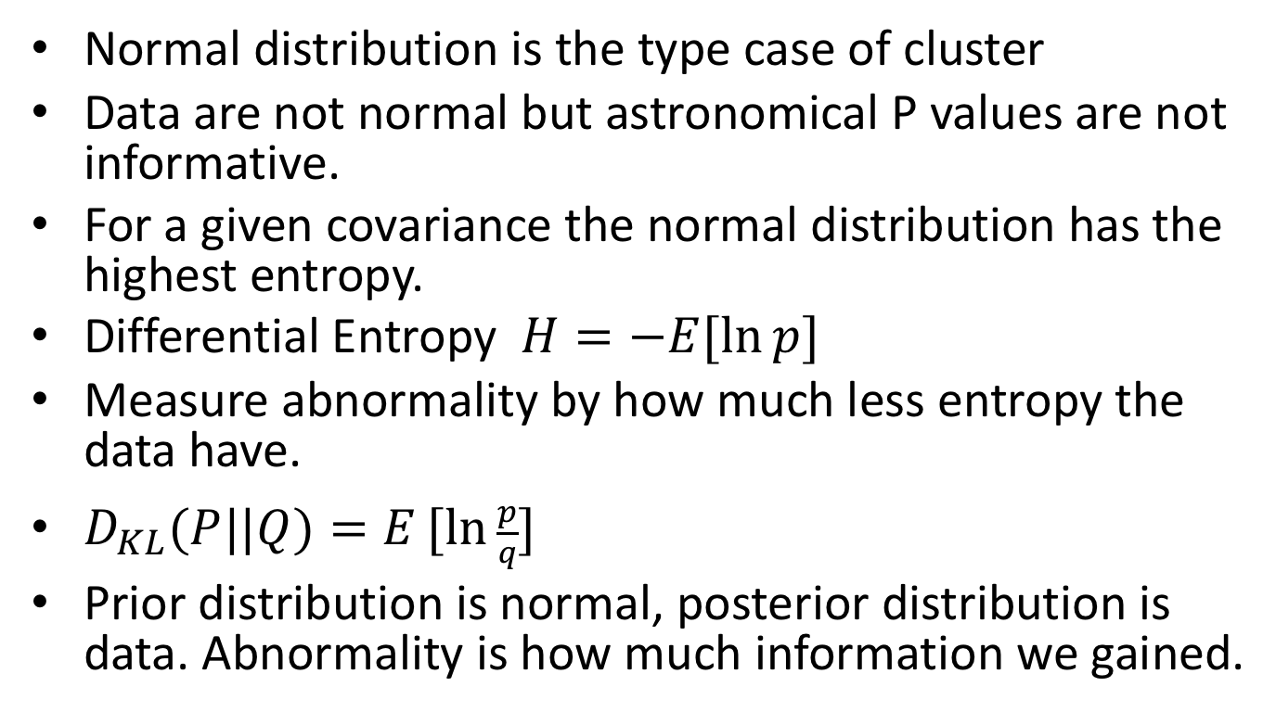
Abnormal Populations
Kullback-Leibler Divergence
Normal distribution is the type case of cluster
Data are not normal but astronomical P values are not informative.
For a given covariance the normal distribution has the highest entropy.
Differential Entropy $H=−E[\ln{p]}$
Measure abnormality by how much less entropy the data have.
$D_{KL}(P||Q)=E[ln{\frac{p}{q}}]$
Prior distribution is normal, posterior distribution is data. Abnormality is how much information we gained.

Slide 17
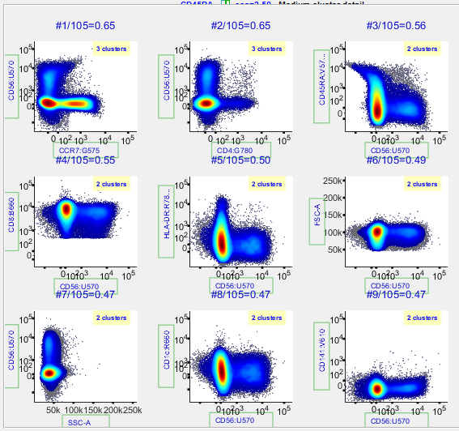
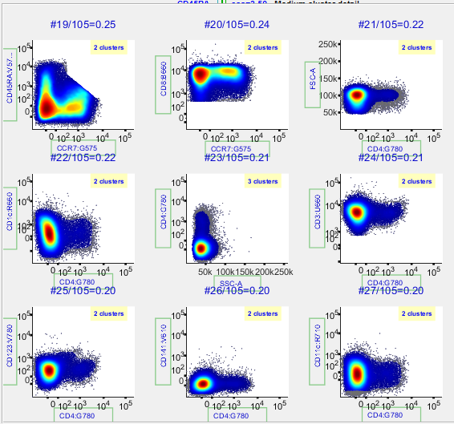
Abnormality
High and Medium

Slide 18
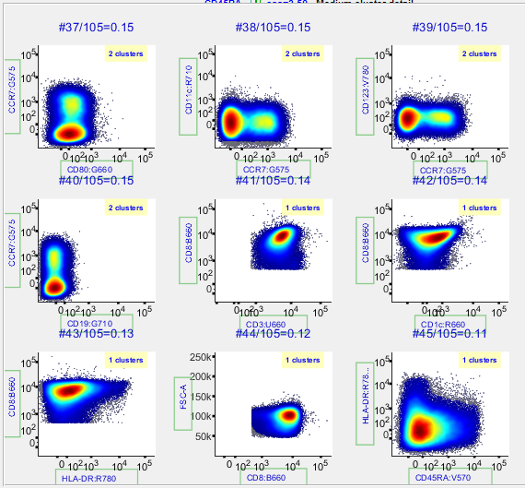
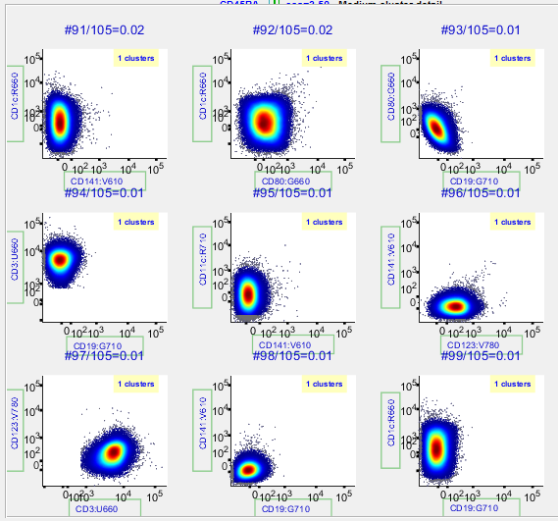
Abnormality
Low and Very Low

Slide 19
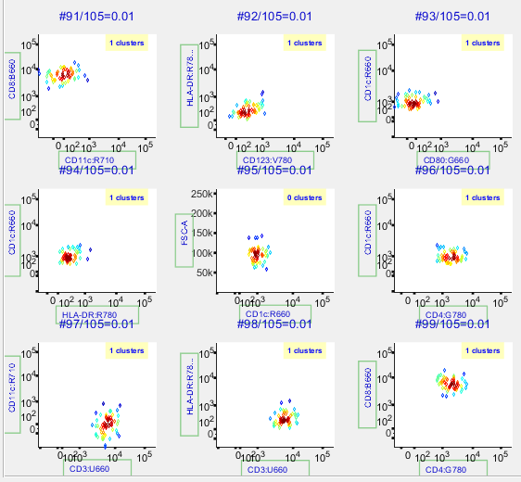
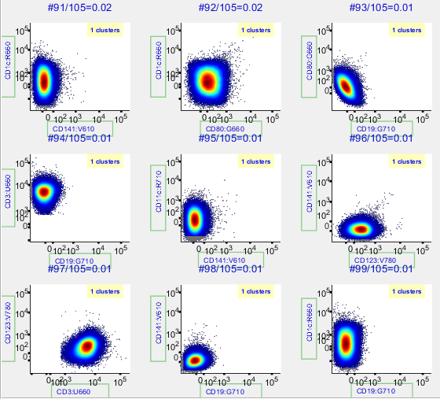
Abnormality
Not sensitive to the number of events
57 Events
12K Events

Slide 20
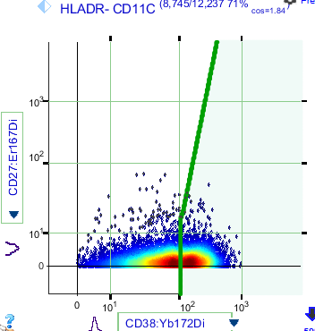
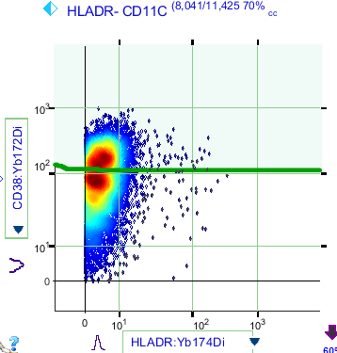
Abnormality
CyToF data not normal at zero

Slide 21
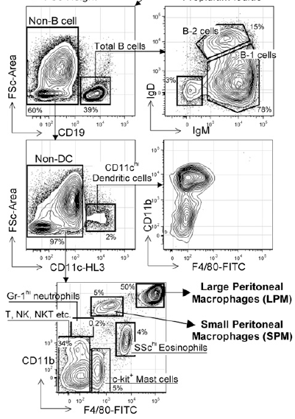
Conventional Analysis
Two physically, functionally, and
developmentally distinct peritoneal
macrophage subsets
Eliver Eid Bou Ghosn, Alexandra A. Cassado,
Gregory R. Govoni, Takeshi Fukuhara, Yang Yang,
Denise M. Monack, Karina R. Bortoluci,
Sandro R. Almeida, Leonard A. Herzenberg, and
Leonore A. Herzenberg

Slide 22
Exhaustive Projection Pursuit
Phenogram (City Block Distance)
Non B Cells
Lymphocytes
Live Singlets
B Cells
Macrophages

Slide 23
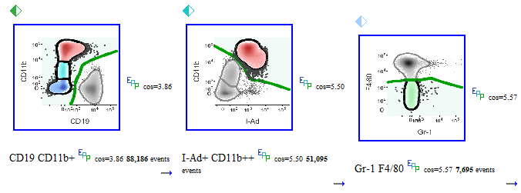
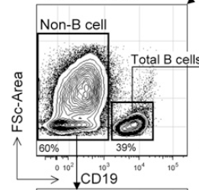
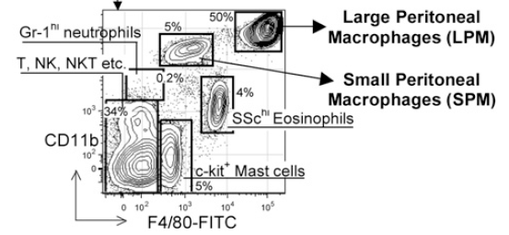
Non B Cells
Same reagents, Different gating

Slide 24
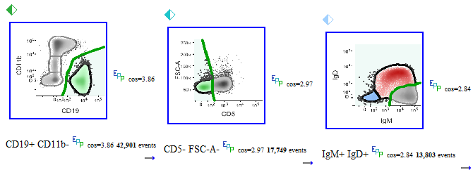
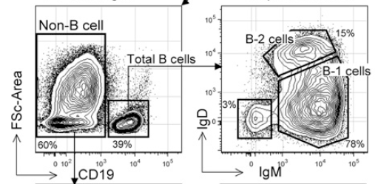
B Cells
CD5 used to distinguish B-1a from B-1b and B-2

Slide 25
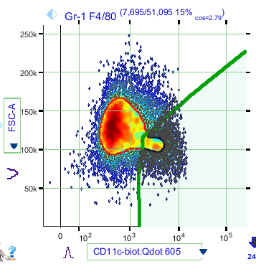
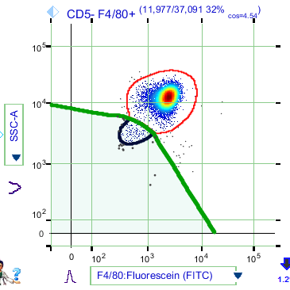
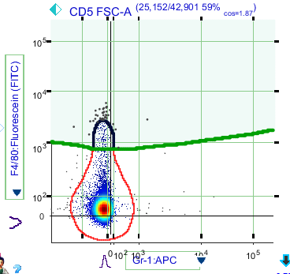
Novel Populations by EPP
SPM
Eosinophils
B-1a?

Slide 26
Summary
Projection Pursuit is simple and easy to explain and to visualize
Exhaustive Projection Pursuit is compute intensive, scales quadratically with dimension but is also highly parallelizable
When simple methods work, use them
When simple methods fail, turn to higher dimensional methods
  Problem is now simpler
  Chances of success are higher

Slide 27
UST
Connor Meehan

Slide 28
The goal of UMAP Supervised Templates (UST)
Quickly and accurately applies/aligns the classifications of a training set to a test set
without re-running the classification

Slide 29

Translated into flow cytometry language…
UST uses the topology and category theory math underlying Uniform Manifold Approximation and Projection (UMAP) to recognize and apply gating patterns.
UST applies gating from one flow sample to compatible samples without re-running the gating method for each.
Gating for the training sample can be by any method: manual, semi-automated or fully automated, e.g., AutoGate Epp, flowMeans, flowSOM, X-shift, SWIFT. As long as the gates are based on reasonable data structure.
This novel approach significantly differs
from conventional clustering methods

Slide 30
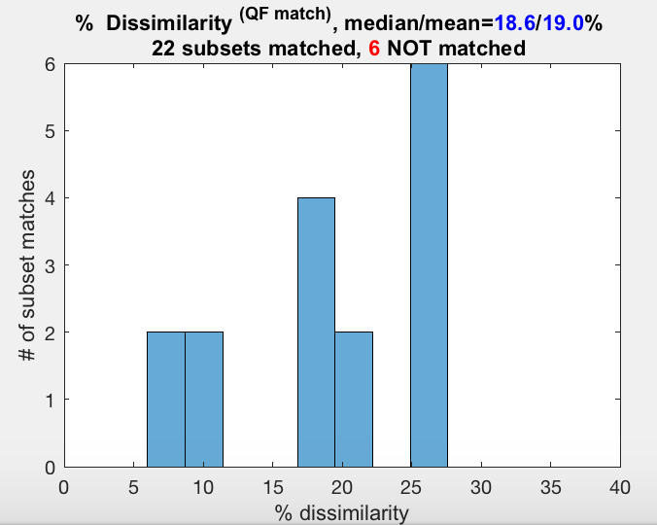
Dissimilarity scores confirm UST's accuracy
Darya Orlova’s QFMatch algorithm produces a percent dissimilarity score (DS) for each match between a UST subset and a classified subset.
The average dissimilarity of all such matches indicates accuracy.
IF
median DS(trainingSet_classified, testSet_UST)
<=
median DS(trainingSet_classified, testSet_classified)
OR
median DS(trainingSet_classified, testSet_UST)
<=
median DS(testSet_classified, testSet_UST)
THEN
the accuracy goal stated on this presentation’s first slide is likely met:
“UST quickly and accurately applies the classifications of a training set (one sample) to a test set (another sample) without re-running the classification (on the test set)”

Slide 31
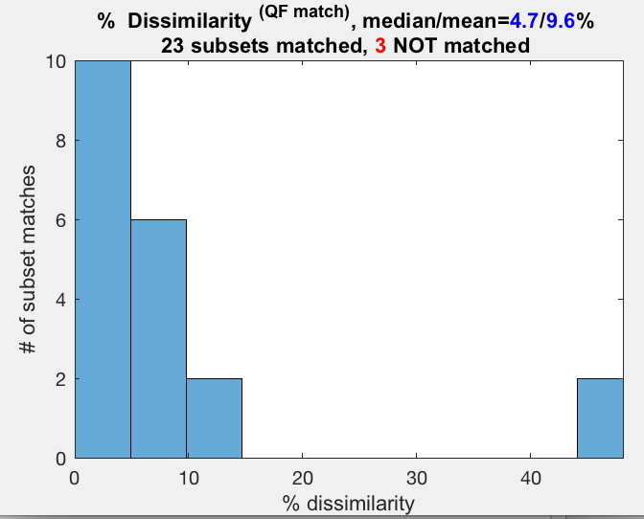
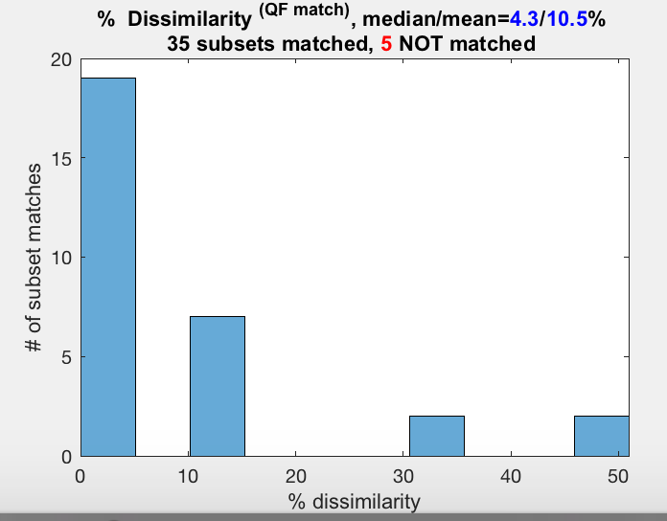
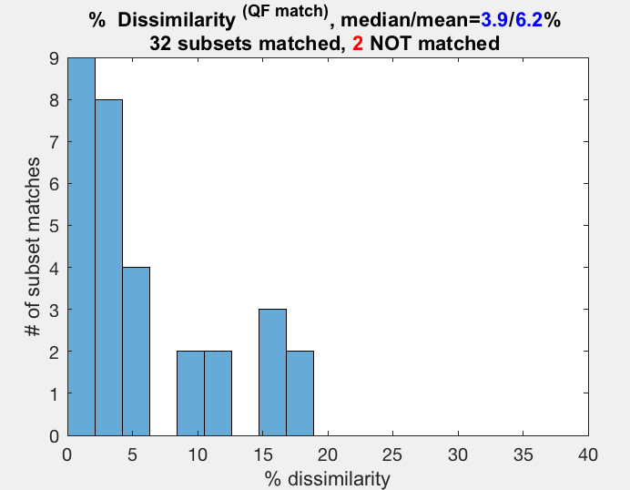
End of the pipeline visualization
Classified subsets
Test set
UST subsets Test set
Classified subsets
Training set
Median DS( trainingSet_classified, testSet_classified )
Median DS( trainingSet_classified, testSet_UST )
Classified subsets
Test set
Median DS( testSet_classified, testSet_UST )

Slide 32
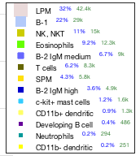
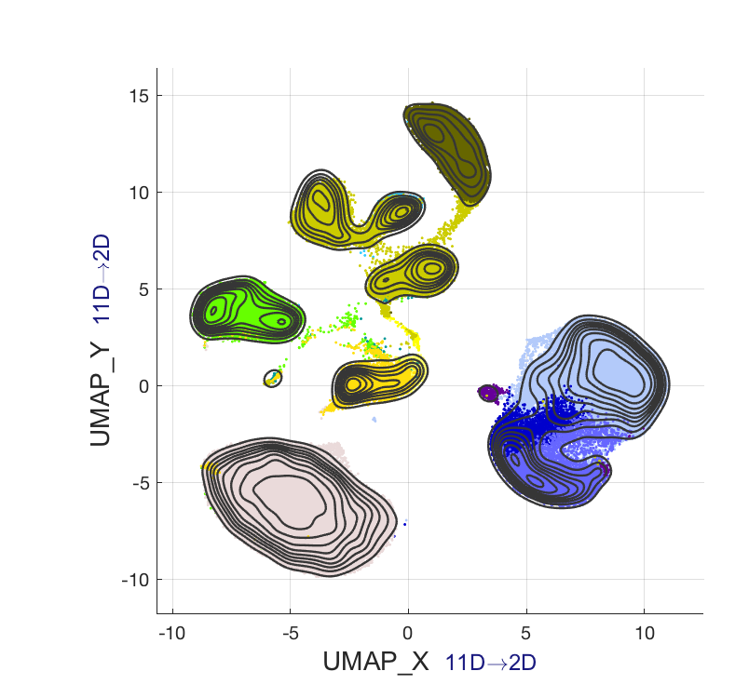
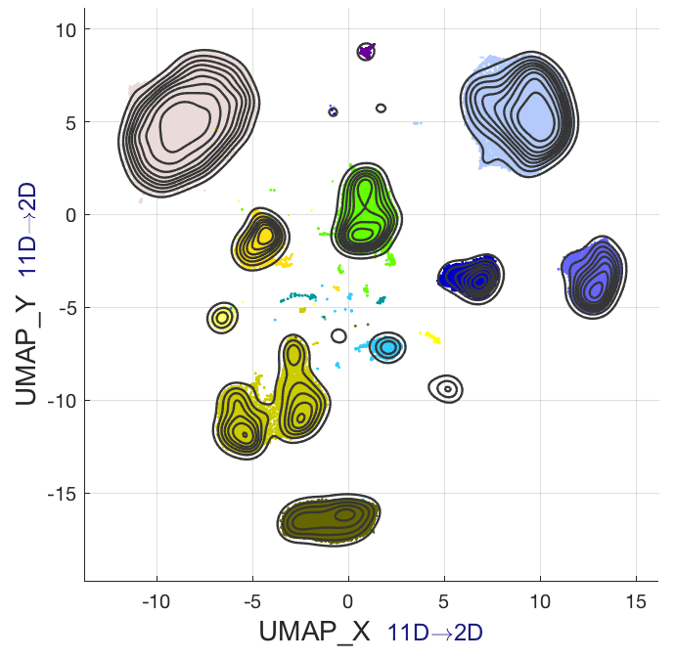
UMAP works better when supervised…
Unsupervised UMAP
(highlighted by manual gates)
Supervised UMAP overlaid with manual gate labels
Supervising finds c-kit+ mast, CD11b+ dendritic, CD11b- dendritic clusters
And … UMAP supervising maintains the subdivision between NK & NKT cells even though they have the same supervising label

Slide 33
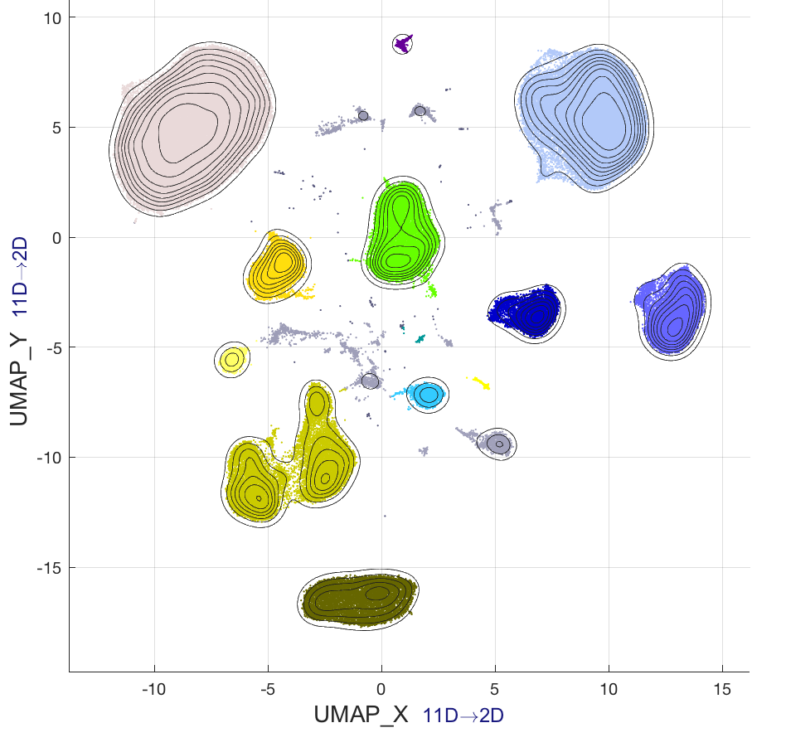
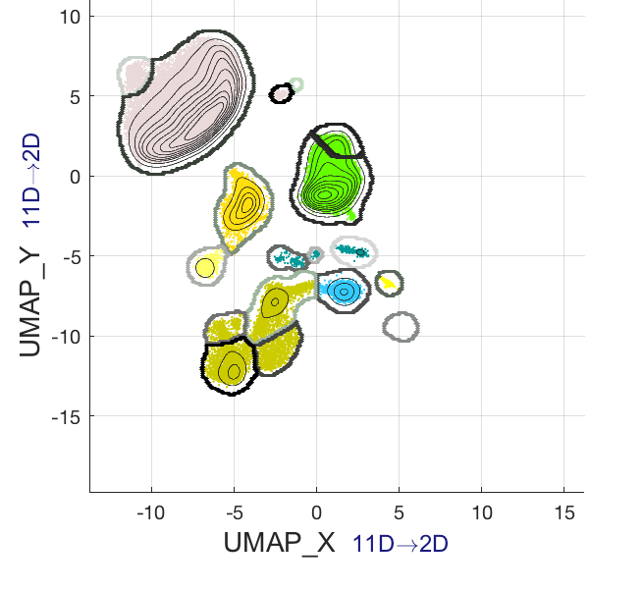
UMAP trained on a normal strain applied to a knockout strain
Supervised UMAP on Balb/c sample
which has all subsets of interest
Template guided UMAP on RAG sample which has no B cells or T cells
UMAP’s supervising and template guiding capabilities confirm that the RAG sample has no B cells or T cells!!!!
And … in the RAG sample they find a 4 way subdivision of the NK & NKT cells even though they are guided by the same original supervising label

Slide 34
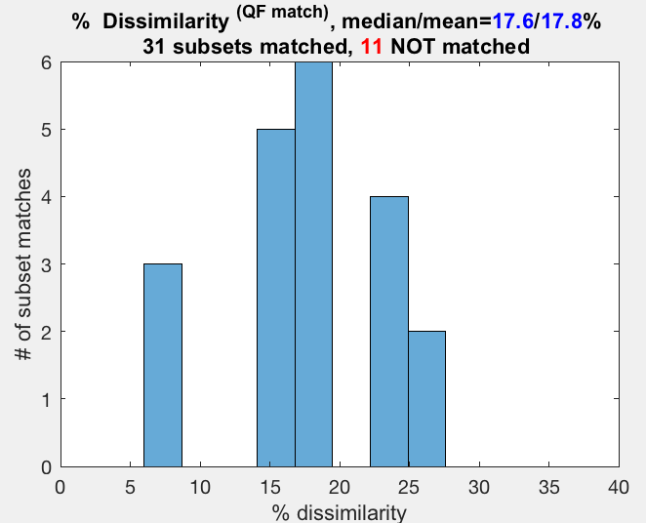
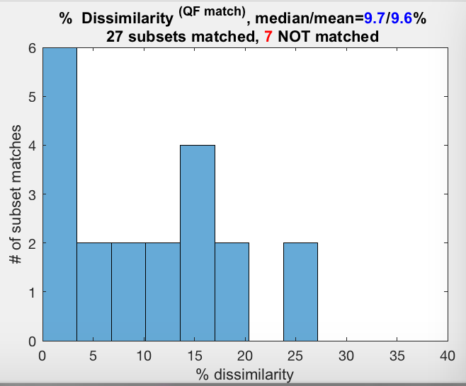
We use dissimilarity scores to determine UST’s accuracy for the subsets which it finds.
Classified subsets
RAG sample
UST subsets
RAG sample
Classified subsets
Balb/c sample
Classified subsets
RAG sample

Slide 35
The Herzenberg UST implementation
UMAP is the invention of Leland McInnes, John Healy, and James Melville
UST harnesses the more advanced UMAP’s main types of parameter reduction:
  Basic parameter reduction
  Supervised parameter reduction
  Template guided parameter reduction
The Herzenberg Lab’s UST implementation is
  A total rewrite of UMAP from Python into MatLab and C++.
  Endowed with additional algorithms for increased accuracy and acceleration
  On average twice as fast as the Python implementation

Slide 36
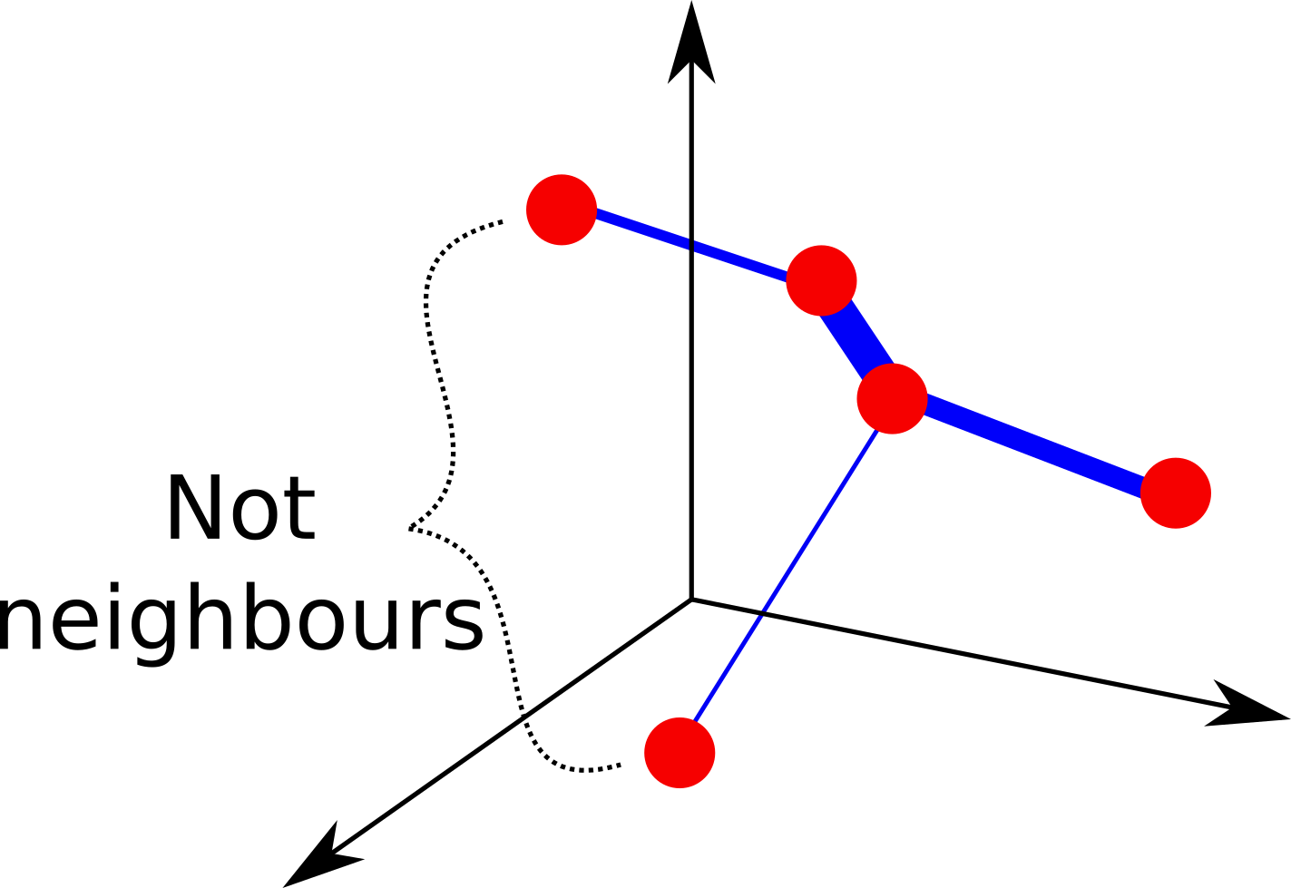
Basic UMAP:
High-dimensional optimization
In high dimension (HiD), UMAP builds a k-nearest neighbour graph among data points
UMAP assigns weights according to how close points are in HiD
Notes:
Line thickness is meant to represent edge weight

Slide 37
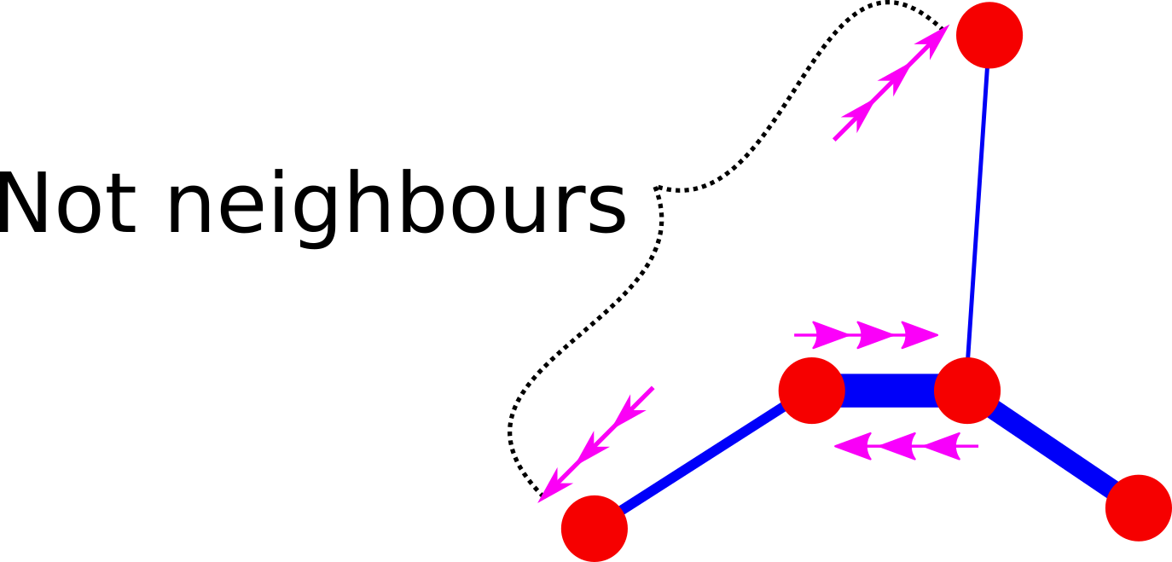
Basic UMAP:
Low-dimensional optimization
UMAP places points into low dimension (usually 2-D) and then optimizes the embedding through gradient descent
Every pair of points pull and push on each other: the heavier the edge between them, the more they pull together, the lighter the edge, the more they push
Notes:
line thickness is meant to represent edge weight.
The purple arrows are intended to represent pulling and pushing.
All pairs in diagram do push/pull but we only show SOME of the arrows to avoid over cluttering

Slide 38
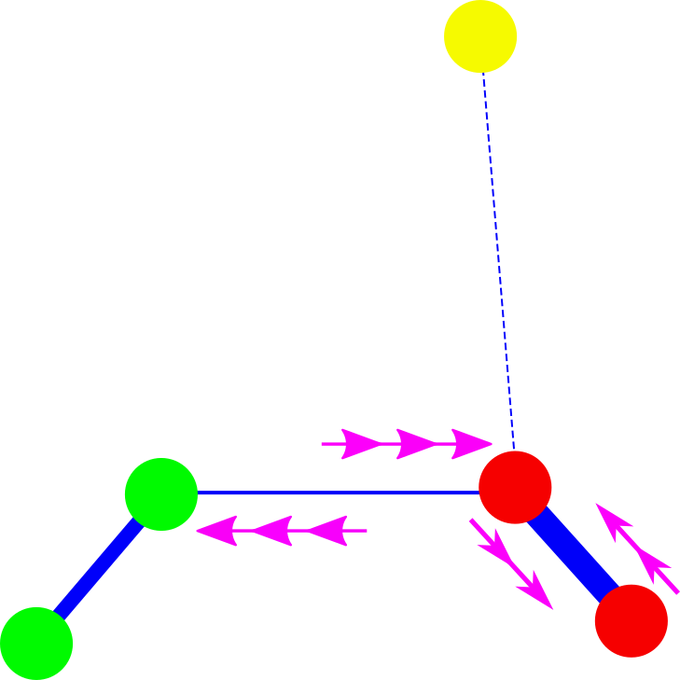
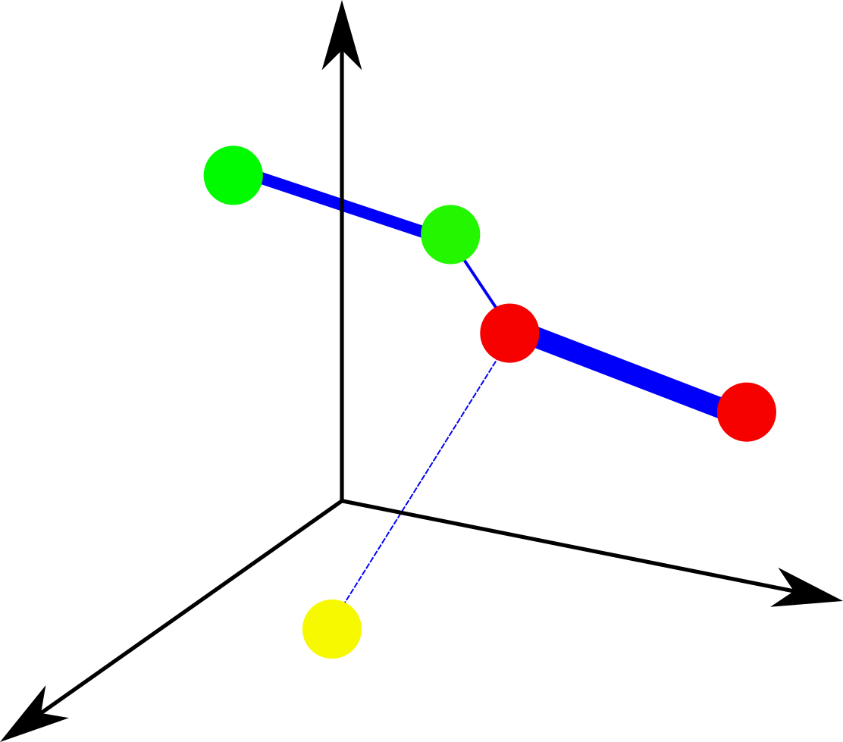
Supervised UMAP
Same except that points with different data labels have their edge weights significantly reduced
Color distinguishes cluster membership
Close points with different labels mostly PUSH … but still PULL a little bit
Notes:
In the supervised diagrams, circle color is supposed to represent the cluster identifiers. So the line thickness between the middle red and green dots got reduced. In the optimization diagram, they are pictured as pushing on each other, but they would pull a little bit too. Just a lot less than before.

Slide 39
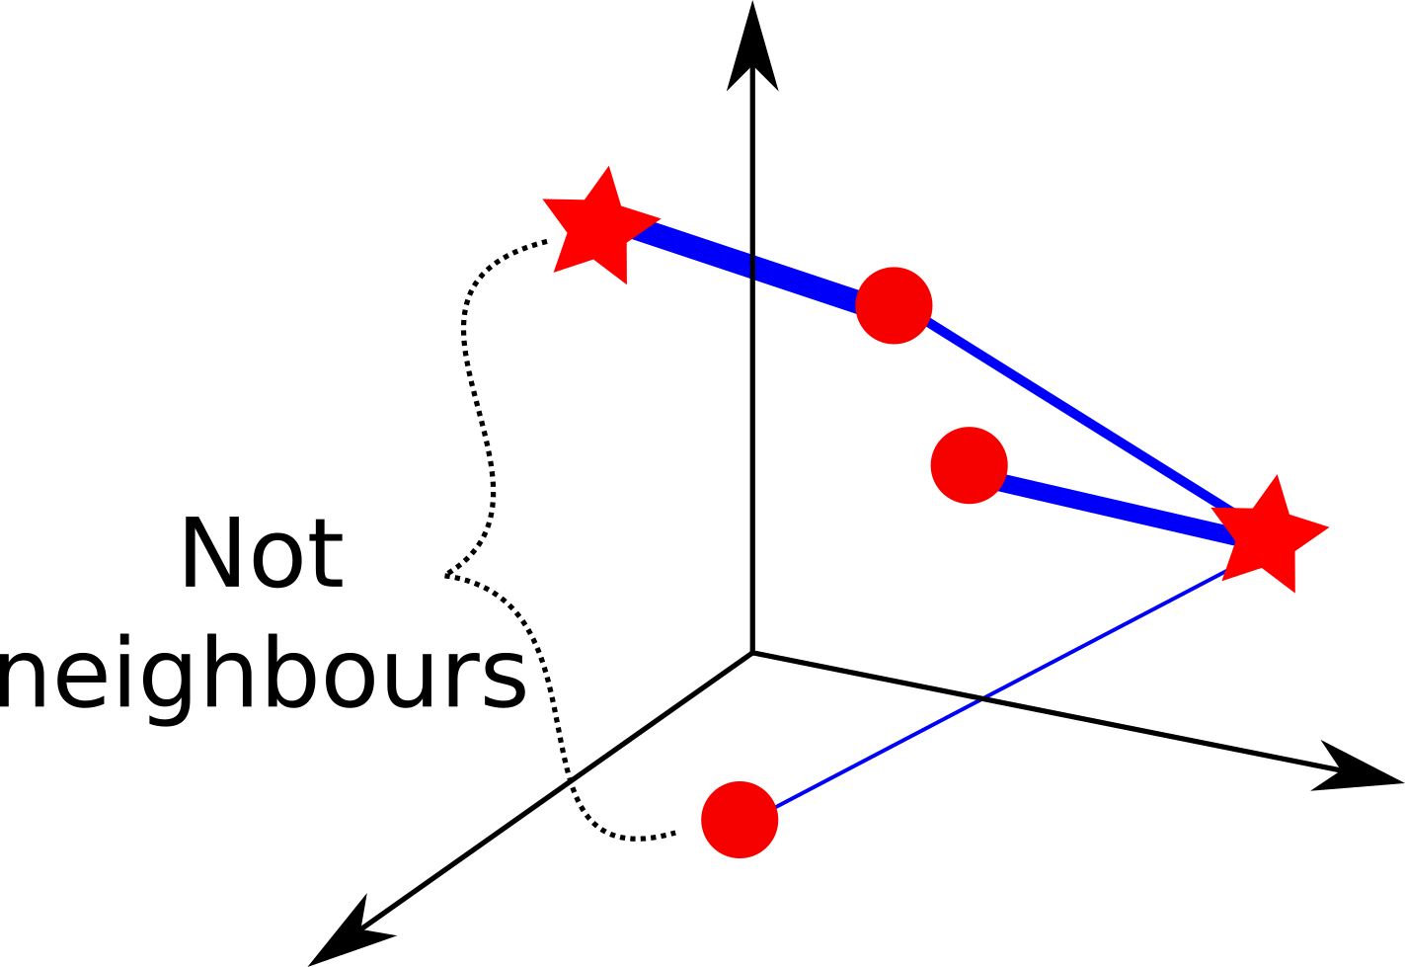
Template guided UMAP
(Transforming data)
Same except that the neighbour graph is only drawn from the test data to the training data
Stars are training data, circles are test data
Notes:
because stars are training data and circles are test data, lines can only ever appear between stars and circles.
The fact that “move_other” is false in template-applying is represented in the optimization diagram by the fact that purple arrows only appear next to circles, not stars.

Slide 40

Template guided UMAP
The pre-established training embedding helps transform the new data into 2-D
Optimization only pushes & pulls new test data

Slide 41
Acknowledgements
Leonore Herzenberg for tireless leadership in automating gating and improving flow cytometry analysis.
Paul Raju, Justin Youngyunpipatkul and Sudhir Babji for ongoing feedback and support for using AutoGate software.
Eliver Ghosn for the published data set used in this presentation
DBM
Automatic Clustering of Flow Cytometry Data with Density-Based Merging
Guenther Walther, Noah Zimmerman, Wayne Moore, David Parks, Stephen Meehan, Ilana Belitskaya, Jinhui Pan, and Leonore Herzenberg
QF Match
QFMatch: multidimensional flow and mass cytometry samples alignment
Darya Y. Orlova, Stephen Meehan, David Parks, Wayne A. Moore, Connor Meehan, Qian Zhao, Eliver E. B. Ghosen, Leonore A. Herzenberg & Guenther Walther
UST
The UMAP algorithm is the invention of Leland McInnes, John Healy, and James Melville at Tutte Institute for Mathematics and Computing

Slide 42
Thank You!
Download
AutoGate at CytoGenie.org
UST source from MathWorks File Exchange
https://www.mathworks.com/matlabcentral/fileexchange/71902-uniform-manifold-approximation-and-projection-umap
Or Google “UMAP MatLab”
Connor Meehan, connor.gw.meehan@gmail.com
Stephen Meehan, swmeehan@Stanford.edu
Wayne Moore, wmoore@Stanford.edu
Herzenberg Lab
Stanford University School of Medicine
Genetics Department
Beckman Center, Room B013
279 Campus Drive, Stanford, CA 94305

Slide 43




What is our “dissimilarity score” based on?
QFMatch is a change quantification metric that is faster than our previously published “Earth Mover Distance” (EMD).
EMD uses exhaustive mass and distance evaluations to compare measurements for all relevant parameters for each subset.

